Slide 1


Slide 2

Presenter
Noelle McCall, CIC, CRM, CCIP, ACRA, CISR
Co-founder of Contract Risk Academy
Director of Contract Risk Management, Peoples First Insurance, Rock Hill, SC
Former National Practice Leader for Contract Review at Marsh & Aon
29 years of insurance industry experience
24 years of contract review consulting experience
Bachelor's Degree - Contracts & Acquisitions Major, International Business Minor
Developer of client-customized tools, insurance requirement templates, and training presentations to simplify and streamline contract review process and reduce clients' contractual risk.
Notes:
4

Slide 3

TODAY'S OBJECTIVES
Understand Indemnity Clauses in Contracts
Definitions, Uses, Goals, Limitations
Legal Impact
How to Support with Insurance
Additional Insured Coverage
Definitions and Uses
Indemnity vs. Additional Insured
Scope Comparison
Sample Wording to Watch
Key Takeaways and Action Items

Slide 4
OBJECTIVE #1
Understand Indemnity Clauses in Contracts
Definitions, Uses, Goals, Limitations
Legal Impact
How to Support with Insurance

Slide 5

Definitions
Indemnity
Compensation to a party for a loss or damage that has already occurred or to guarantee through a contractual clause to repay another party for loss or damage that may occur in the future
When one party agrees to assume liability of others and pay for their liability
Laws vary by state if indemnity automatically includes hold harmless, and/or defense, or if these need to be specifically required in contract
Indemnify
To pay or compensate the other party for its legal liabilities or losses.
Can indemnify for damages, which typically don’t arise until the end of a case or resolution, or
Can indemnify for liabilities, which are broader and require the indemnitor to pay as soon as the indemnitee becomes liable

Slide 6
Indemnitee
Party that receives compensation from the indemnitor for incurred injury, loss, or damage
Person or organization that is held harmless in a contract (by the indemnitor)
Indemnitor
Party that agrees to assume liability of others and pay for their liability
Person or organization that holds another (the indemnitee) harmless in a contract
E.g., insurance policy is an indemnity agreement.
Indemnitee = Named Insured
Indemnitor = insurance carrier
Claimant
Party who files a claim against Indemnitee

Slide 7
Hold Harmless
A clause in a legal contract absolving one party of legal liability for any injuries or damages suffered by another party
Ensures that one party cannot hold the other party legally responsible for any risks incurred from services provided
Defend
Requires indemnifying party to engage attorneys and manage litigation or other proceedings when a claim covered by the indemnification provision is brought against indemnitee
Obligation includes defending, financing a defense, or reimbursing an indemnitee for defending a claim
Duty to defend arises as soon as a claim is asserted against an indemnitee
Some states (e.g., CA), don’t require indemnitor to be found liable before there is a duty to defend if contract specifically requires defense

Slide 8
How are Indemnity Agreements Used?
Protects the indemnified party from liability arising from third-party claims by legally transferring financial risk from the indemnitee to the indemnitor
Non-insurance contractual risk transfer—risk financing technique
May prevent indemnitor from making claims against the indemnified party (hold harmless).
May require indemnitor to provide defense for indemnitee

Slide 9

Some Limitations on Indemnity
Contract requirements
State laws
Interpretation by courts
Indemnitor’s lack of financial capabilities
Insurance coverage–or lack of it
Does not prevent reputational damage
Does not free indemnitee from responsibility to third party
Indemnitee may still be held accountable for injury or damage

Slide 10
Some Limitations on Indemnity (cont.)
No indemnity for illegal acts
Can’t be used to shield indemnitees against liability and fines for illegal acts
Creation of Uninsurable Losses
Insurance typically does not cover intentional misconduct & illegal acts
All insurance policies include limitations and exclusions.
If you are required to indemnify for these, you could be paying out of pocket for uninsured losses

Slide 11
Limitation of Liability (LoL)
Clause in contract that limits the amount of money or damages that one party can recover from another party for breach of contract or failure to perform
Can be used to add a cap on amount of damages the organization will have to pay under certain circumstances
Limitation of Liability (LoL) Caps are Common
Examples
Indemnitor only liable for losses up to $500,000. ‌
Indemnitor only liable for amounts paid to indemnitor by indemnitee over past 12 months

Slide 12
Pro Tip!―Limitation of Liability (LoL) clauses may also cap insurance requirements
Consider how LoL caps may impact you
For example
If you are the indemnitor, you may prefer to have an LoL cap in your own favor to limit your liability to the indemnitee
If you are the indemnitee, you may prefer no LoL cap or only want to permit an LoL cap in your favor

Slide 13
Some Limitations on Indemnity (cont.)
Duration of Liability
Liability can end when contract ends or continue beyond contract term
Statutory Limitations
Legal proceedings must be initiated within a set time period determined by law or you waive your right to sue.
Statute of Repose – Laws add time limit to file suit after some action by the defendant, even if the plaintiff has not yet been injured.
Statute of Limitations – Time limit on a potential plaintiff’s right to file a civil lawsuit after suffering some kind of harm

Slide 14
Are All Indemnification Clauses Enforceable?
In general, courts don’t enforce provisions that are:
Ambiguous
Unfair
The result of gross negligence
Protection against illegal acts
Violate public policy

Slide 15


Typical Indemnity Goals
Which side of the table are you on?
If you are the indemnitee, you may want
If you are the indemnitor, you may want
Indemnitor to fully indemnify you regardless of who was at fault
Protection to the fullest extent legally possible
Limitation of Liability cap only in your favor and none for indemnitor—no limit on indemnity & insurance paid to/for you
Indemnity agreement that only holds you liable for your own negligent acts for third party claims & breach of contract
Limitation of Liability cap in your favor, without carve out for insurance—caps indemnity & insurance limits paid to indemnitee
Notes:
22

Slide 16
Some Additional Indemnity Goals
Use clear language and avoid any ambiguity
Consider the scope of work. Draft indemnity requirements to specifically cover anticipated losses without being overly broad
Try to avoid agreeing to indemnify others for uninsurable losses
Beware of “unlimited” indemnity clauses that can put your company at significant legal risk
Consider adding a Limitation of Liability cap in your favor
Clarify the trigger for indemnification

Slide 17

Impact of Law on Indemnity
State laws impact if, and how, indemnity may apply
Well-drafted indemnity agreements may supersede common law, allowing indemnification from indemnitors, sometimes even for indemnitee's sole negligence.
Don’t assume all indemnity provisions are void when assuming liability for another's sole negligence.

Slide 18
For construction contracts, most states do not allow indemnification for indemnitee’s sole negligence
Many states consider this against public policy, as indemnitees may not be as careful if they know they can transfer financial risk of their sole negligence to an indemnitor
If written broader than law allows, courts may throw out indemnity clause altogether

Slide 19
OBJECTIVE #2
2. Additional Insured Coverage
Definitions and Uses

Slide 20
How to Support Indemnity with Insurance
Indemnity
Additional Insured
Contractual Liability
Notes:
29

Slide 21
Definitions
Named Insured – persons or entities to whom the policy is issued
Automatic Insured – persons or entities who are automatically provided with insured status in the policy because they are members of a group with close ties to the named insured, such as the named insured's directors and officers
Additional Insured (AI) – persons or entities who are granted insured status in conjunction with business relationship and/or contract requirement
Pro Tip! – an AI is not an Additional Named Insured, even if the AI is named on the AI endorsement

Slide 22
Why Add Additional Insureds?
One company may have a desire to protect another party because of close relationship with that party.
For example:
Wanting to protect church members performing services for the insured church
A company (named insured) may need to comply with a contractual agreement requiring the named insured to add an additional insured to their liability policy.
For example:
Project owners, customers, or owners of property leased by the named insured

Slide 23
Common Uses for AI Coverage
Often used in coordination with indemnity agreement between named insured (indemnitor) & AI (indemnitee)
Transfers contractual risk
Contracts require add upstream parties as AI on downstream parties’ policies.
E.g., general contractor added as AI on Contractor’s policies
Helps support indemnity obligations
“Belt & Suspenders”
Backup option if indemnity is unenforceable
Another source of money if indemnitor does not (or cannot) pay

Slide 24
OBJECTIVE #3
3. Indemnity vs. Additional Insured
Scope Comparison
Sample Wording to Watch

Slide 25
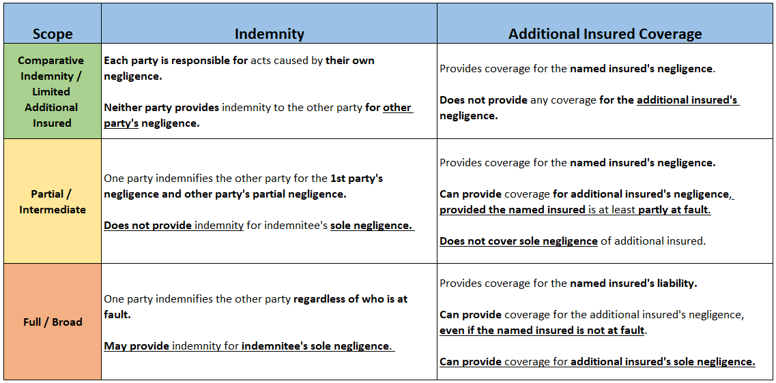
Indemnity vs. Additional Insured

Slide 26
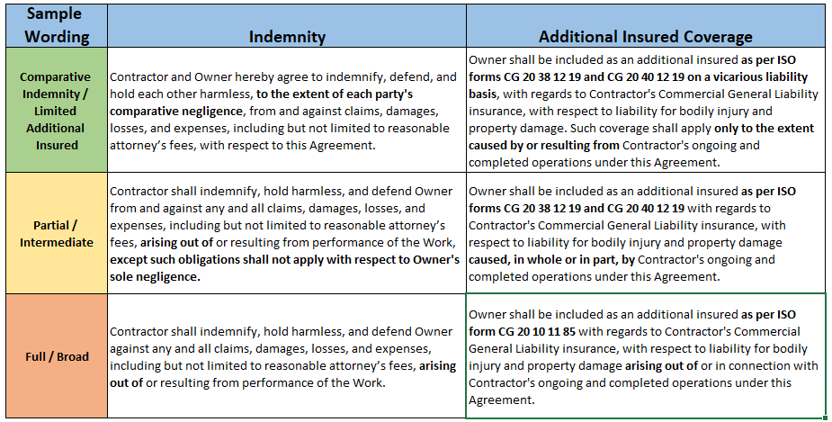
Indemnity vs. Additional Insured

Slide 27






Indemnity – Sample Nexus Wording
Solely
To the extent
Directly
Caused by or resulting from
Directly or indirectly
Arising out of or related to
In connection with
Alleging that
Notes:
38

Slide 28

Limited Indemnity Example
Contractor agrees to indemnify, defend, and hold harmless Owner, from and against claims, damages, losses, and expenses, including but not limited to reasonable attorney’s fees, solely to the extent directly caused by or resulting from Contractor's negligence in performance of Contractor's operations under this Agreement
Notes:
39

Slide 29

Broad Indemnity Example
Contractor shall indemnify, hold harmless, and defend Owner from any and all losses, claims, liens, demands, and causes of action of every kind and character including, but not limited to, the amounts of judgments, penalties, interest, court costs, legal fees, and all other expenses incurred by Owner arising in favor of any party, including claims, liens, debts, personal injuries, death, or damages to property (including employees or property of Owner) and without limitation by enumeration, all other claims or demands of every character occurring, or in any way incident to, in connection with, or arising, directly or indirectly out of, the contract or agreement.
Notes:
40

Slide 30



Key Takeaways & Action Items
Understand
Know
Review
How indemnity and limitation of liability work.
Understand how Additional Insured coverage can help support indemnity obligations in clients’ contracts.
The three basic levels of indemnity and Additional Insured coverage.
Know what wording to watch for to identify levels of Additional Insured coverage.
Clients’ liability policies to see what Additional Insured coverage is included.
Discuss with clients and request endorsements to support contractual obligations.

Slide 31
Contact Information
Noelle McCall, CIC, CRM, CCIP, ACRA, CISR
Co-founder of Contract Risk Academy
Director of Contract Risk Management
http://www.contractriskacademy.com
803.203.8275
nmccal@peoplesfirstinsurance.com
Noelle McCall, CIC, CRM, CISR | LinkedIn
Notes:
42

Slide 32
Disclaimer
DISCLAIMER: Insurance forms and endorsements vary based on insurance company; changes in edition dates; regulations; court decisions; and state jurisdiction. These instructional materials provided by Contract Risk Academy ("CRA") are intended as a general guideline and any interpretations provided by the instructor or the creator(s) of these materials do not modify or revise insurance policy language. In providing these materials, the authors assume neither liability nor responsibility to any person or business with respect to any loss that is alleged to be caused directly or indirectly as a result of the instructional materials provided.
Any statements concerning legal matters are based solely on our experience as insurance brokers and risk consultants and are not to be relied upon as legal advice, for which you should consult your own professional legal advisors. The information contained herein is based on sources we believe reliable, but we make no representation or warranty as to its accuracy. CRA shall have no liability to you or any other party with regard to the instructional materials. CRA makes no representation or warranty concerning the application of policy wordings or the financial condition or solvency of insurers or reinsurers. CRA makes no assurances regarding the availability, cost, or terms of insurance coverage. All decisions regarding the amount, type or terms of coverage shall be your ultimate responsibility. While CRA may provide advice and recommendations, you must decide on the specific coverage that is appropriate for your particular circumstances and financial position. By accepting this report, you acknowledge and agree to the terms, conditions, and disclaimers set forth above.
https://contractriskacademy.com
Copyright © 2025 Contract Risk Academy. All rights reserved.
Notes:
43

