Slide 1
Online Auto Insurance
Presented to IIABA ACT
Susan Engleson, Senior Director | September 27, 2013

Slide 2








comScore is a leading internet technology company that provides Analytics for a Digital World™
 | NASDAQ | SCOR
 | Clients | 2,100+ Worldwide
 | Employees | 1,000+
 | Headquarters | Reston, Virginia, USA
 | Global Coverage | Measurement from 172 Countries; 44 Markets Reported
 | Local Presence | 32 Locations in 23 Countries
 | Big Data | Over 1.5 Trillion Digital Interactions Captured Monthly
V0113

Slide 3




comScore 2 Million Person Global Panel
Comprehensive View of Digital Consumer Behavior
Online
Advertising
Video
Search
Online
Behavioral
Profiles
E-Commerce
Website and
App Usage
Demo-
graphic
Profiles
PC
TV
Gaming
Server
Smart
phone
POS
Tablet
V0113

Slide 4
Broader Context

Slide 5
In the past 12 months, ownership of smartphones has risen from 47% to 59% among those with a mobile device in the U.S.
Growth of U.S. Smartphone Installed Base
Smartphone Growth Over the Past Year
59%
Not Smartphone
47%
Smartphone
Smartphone Penetration by Month:
47% | 49% | 50% | 51% | 52% | 53% | 54% | 55% | 56% | 58% | 58% | 59% | 59%
Source: MobiLens™ : 3-mth rolling averages

Slide 6
Smartphones and Tablets have driven a doubling of time spent with digital media over past 3 years
Total Digital Media Time Spent (Billions of Minutes) by Platform
Source: comScore Media Metrix Multi-Platform, U.S., May 2013 vs. May 2010
+93%
+370%
+15%

Slide 7
Overall desktop audience is flattening, while mobile is steadily growing - more people are engaging on multiple platforms
Total Digital Populations (000) by Platform
Source: comScore Media Metrix Multi-Platform, U.S., Feb-2013 – Jun 2013
Desktop Audience Trend
Mobile Audience Trend
Overlapped Audience Trend

Slide 8
One third of the average retailer’s monthly web site visitors now arrive exclusively via mobile devices
Selected Leading Retailers: Total U.S. Digital Population
Unique Visitors (000) by Platform
Source: comScore Media Metrix Multi-Platform, U.S., June 2013
149M
91M
59M
55M
37M
28M
The average Top 50 retailer extends its desktop audience by
54% via mobile channels
25M
19M
18M
18M
Note: Mobile = Smartphone + Tablet

Slide 9
Shopping & Buying Insurance
Subtitle

Slide 10
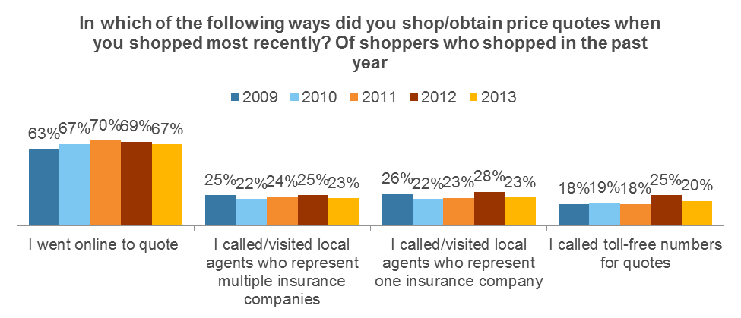
Consumers are going online to quote…

Slide 11
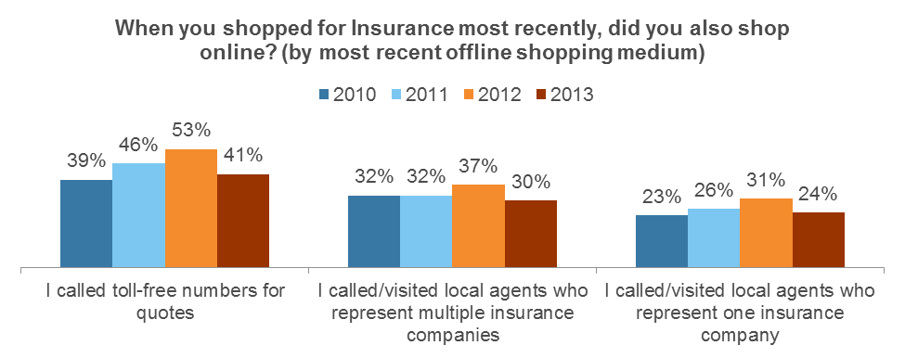
…Even those who quote on the phone and with agents

Slide 12
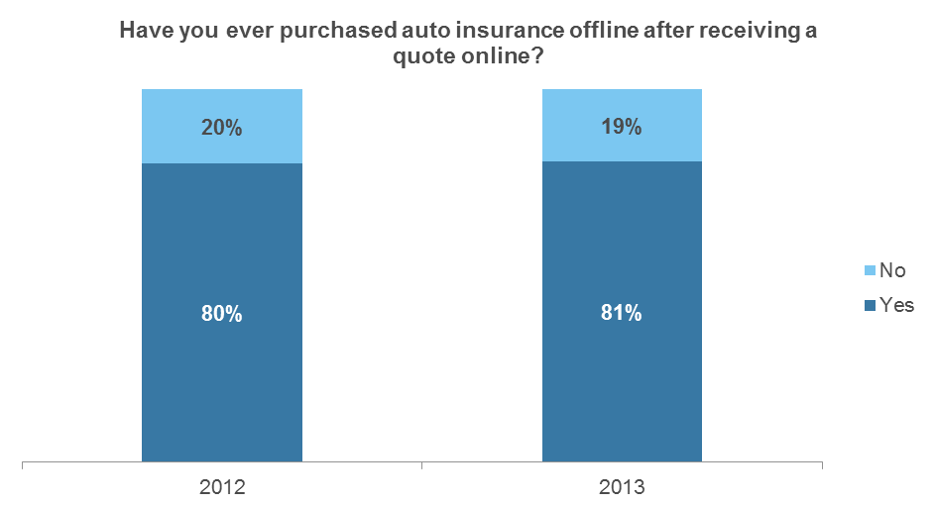
But many consumers quote online and buy offline…

Slide 13
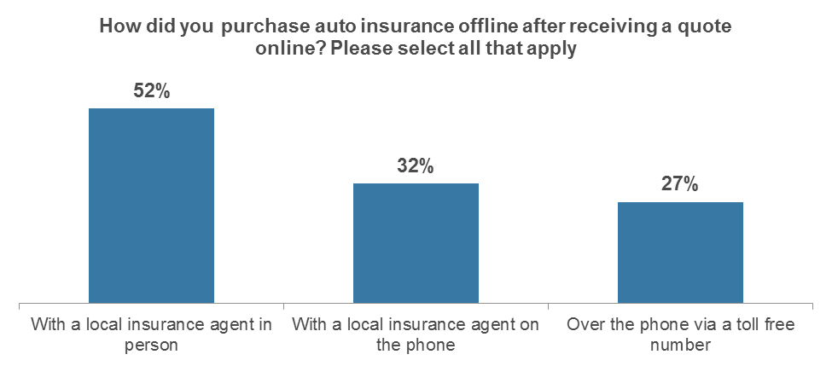
…Most often with a local agent in person.

Slide 14
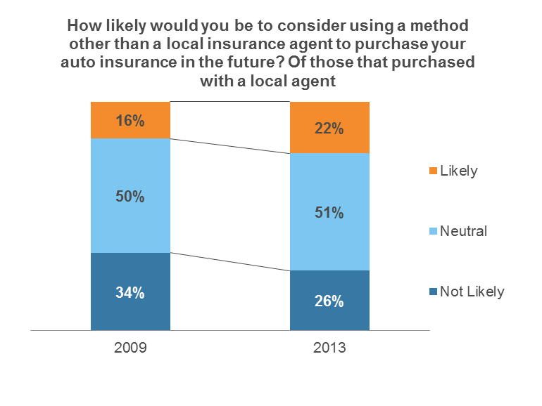
That said, the tides are shifting

Slide 15
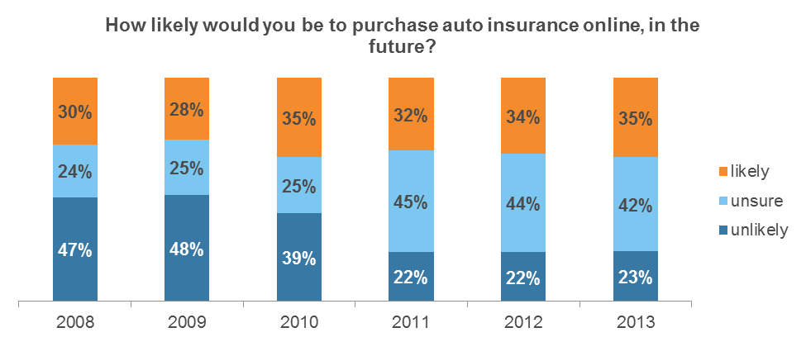
Consumers are warming to the idea of buying online

Slide 16
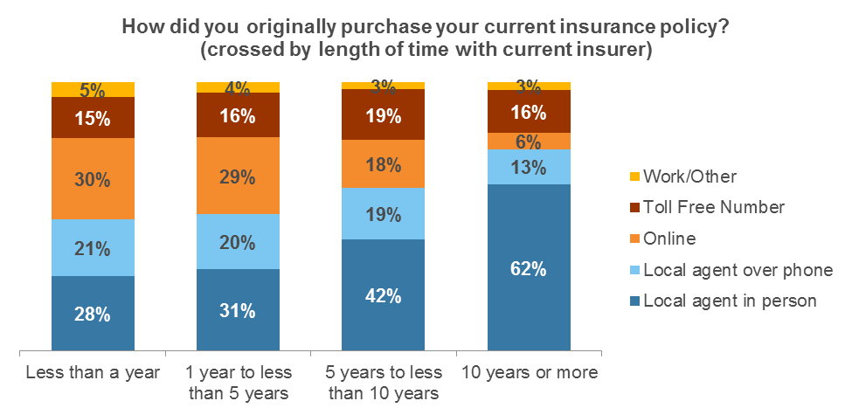
Direct (online + phone) is gaining on local agents

Slide 17
The Online Picture

Slide 18
Online Insurer Quotes Decreased 4% Y/Y In 2012, With Over 32 Million Annual Submits
Y/Y % Change
+16%
+20%
+0%
+19%
+1%
+5%
-4%
34.1
32.1
32.6
32.7
26.9
26.9
22.4
*Additional Insurance sites were included in the insurance visitor set:
Q1 07 – 21st.com, TheHartford.com
Q1 08 – LibertyMutual.com, TheGeneral.com
Q1 09 – travelers.com, safeauto.com
Q1 11 – usaa.com, directgeneral.com, farmers.com, unitrindirect.com,
amica.com, calif.aaa.com

Slide 19
Top Insurers Overall and for Online Quotes
2012 % of US Auto Insurance Premiums
2012 % of Online Insurer Quotes Submitted
USAA – 4.9% Share
American Family – 1.9% Share
Source: AM Best
Source: comScore, Inc.

Slide 20
GEICO captured 29% share of Insurer Submitted Quotes in 2012
Yearly Online Auto Insurance Industry: Insurer Share of Submitted Quotes

Slide 21
Annual Policies Purchased were flat Y/Y in 2012. Market is dominated by GEICO and Progressive.
35%
58%
37%
8%
22%
3%
6%
0%

Slide 22
GEICO, State Farm, Progressive most visited sites
Online Auto Insurers: Unique Visitors
(in Millions)
PC Data Only

Slide 23
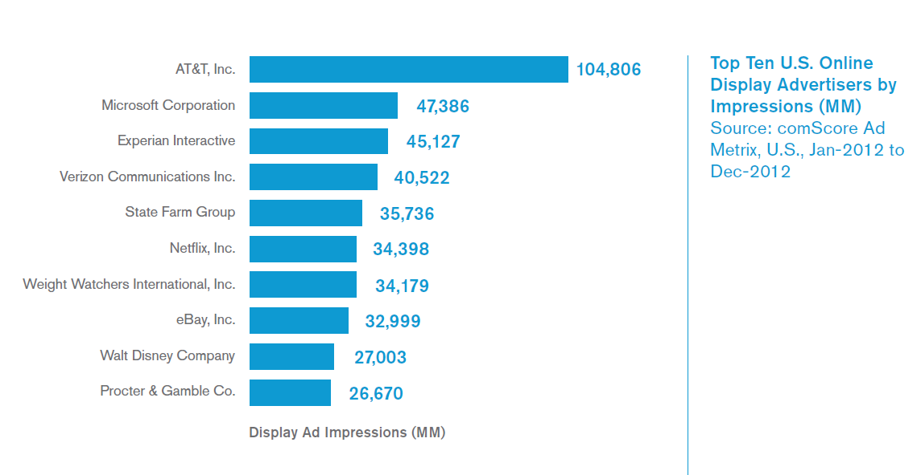
State Farm ranked among the top 10 U.S. Online Display Advertisers in 2012

Slide 24
Amfam saw a 26% increase in traffic Y/Y with 1.5 million visitors in Q4 2012
*Farmers.com includes data to farmers.com as well as farmersagent.com
* = denotes small sample
PC Data Only

Slide 25
While Liberty Mutual Insurance saw a decrease Q/Q in online display ad impressions in Q2 2013, Safeco saw a significant increase
Liberty Mutual/Safeco Online Display Ad Impressions
(in Millions)

Slide 26
Safeco saw a significant Q/Q increase in unique visitors in Q2 2013 with over 950K
Safeco Unique Visitors
(in Thousands)
*Denotes small sample size

Slide 27
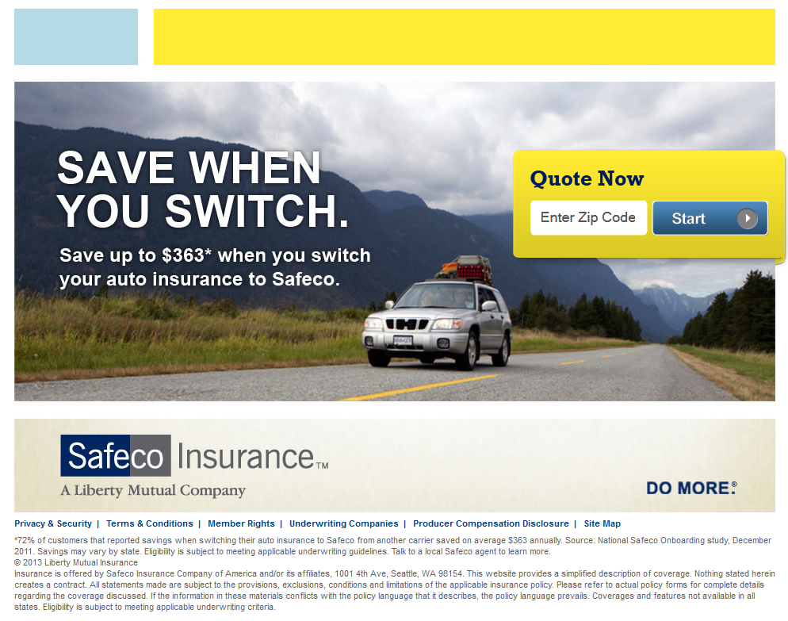

Safeco’s increase in traffic Q/Q is due in part to several new landing pages in Q2 that had significant traffic
There were 82K unique visitors to the Save When You Switch landing page and 55K to the Accident Forgiveness page in Q2 2013, both of which had very minimal traffic in Q1.

Slide 28

Travelers was relatively flat in quotes submitted Q/Q, but has pulled back in search, display, and affiliates
Q/Q Chg.
Travelers: | -6%
Industry: | -2%
Travelers

Slide 29
How do independent agents win?

Slide 30
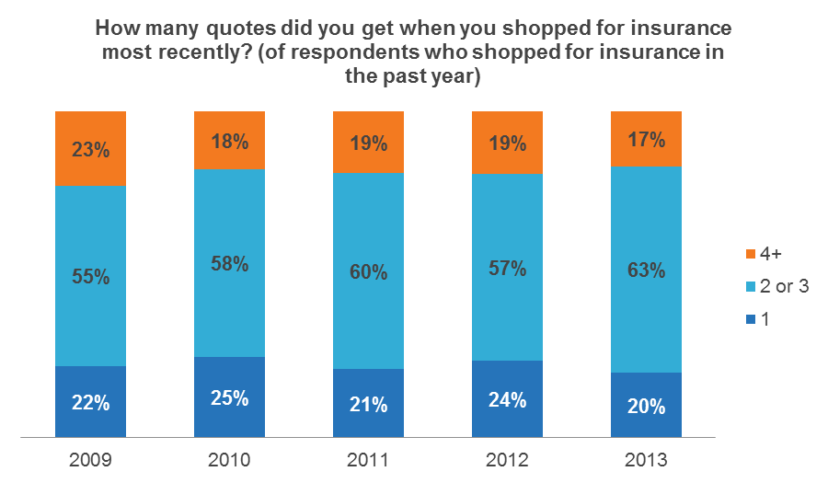
Shoppers want to get multiple quotes…

Slide 31
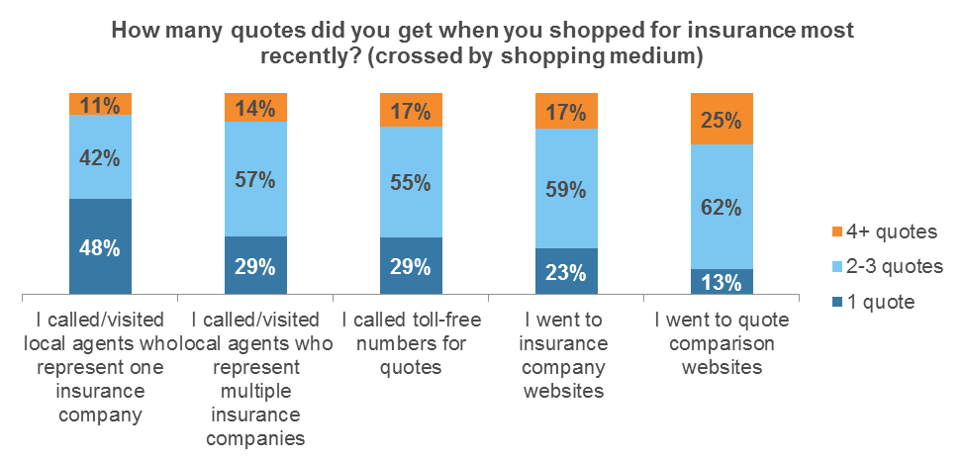
Independent Agents Provide That

Slide 32
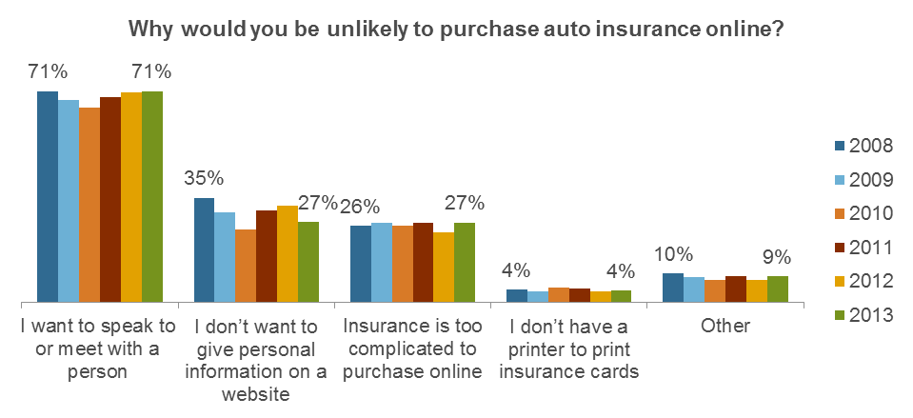
People (23% unlike to purchase online in the future) want to talk to someone

Slide 33
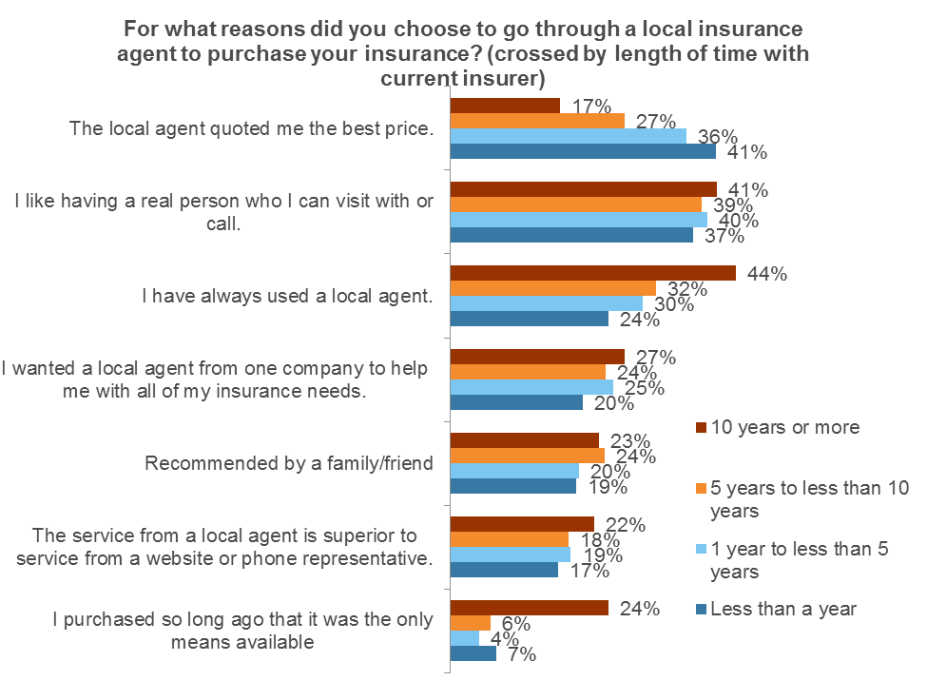
Agents do still need to be price competitive!

Slide 34
UBI, Bundling, Servicing

Slide 35
UBI positioning within the quote process
Insurer | Device | Positioning within Quote Process
Progressive | SnapShot | At the Final Details step before the Quote Submit page Also a separate Snapshot Test enrollment process
State Farm | Drive Safe & Save | Step: Vehicles Section: Add Vehicles
Allstate | Drive Wise | Step: Discounts Section: Additional Discounts
Esurance | DriveSense | Step: Primary Driver Information – Continued Section: Discounts
Esurance (PAYD) | Drive Less Save More | Step: Discounts & Savings Section: Discounts & Savings
Nationwide | SmartRide | Step: Discounts Section: Discounts
The Hartford | TrueLane | Step: Vehicle Info Section: 3rd section on the Vehicle tab
Travelers | IntelliDrive | On the quote submit page (select quotes only)
Notes:
http://analysis.telematicsupdate.com/risk-management/progressive-launches-new-insurance-telematics-program-strategy-analytics-predicts-co
http://reviews.cnet.com/8301-13746_7-20025220-48.html
http://allstatenewsroom.com/releases/38d7c66f-0974-4b85-84f6-1f8a5a9d73b2
http://www.esurance.com/news/2012-esurance-launches-car-insurance-in-nebraska

Slide 36
Insurers who offer online bundling
Insurer | Bundle Opportunities | Bundle From Auto | Bundle From Home/Renters | Outcome
Allstate | Auto + Renters | Yes – Discounts page; page of renters questions after Discounts within the auto process | Yes (Renters) – from quote initiation screen (taken directly to auto process first) | Buy both policies
Esurance | Auto + Renters (RentersPlus endorsement on Auto Policy) | Yes – quote summary page (certain states only); additional renters questions asked during policy purchase | Yes (Renters) – Landing page before quote initiation screen (taken directly to auto process first) | Buy both policies
Progressive* | Home/Renters + Auto | Yes – pop-up before quote initiation page; complete auto quote and then home/renters quote | No – Bundle discount reminder displayed in the side panel throughout the quote process, but not option to add auto | Buy both policies
The Hartford | Auto + Home | Yes – quote summary page (certain states only); shoppers continue to get a homeowners quote and receive a bundled price for both policies | No – standalone homeowners quoting not available online | Call agent to bundle
Liberty Mutual | Auto + Home/Renters | Yes – quote summary page (certain states only); shoppers can add renters insurance by answering 2 additional questions | Yes – quote summary page (certain states only); shoppers can get an auto quote to add on to homeowners | Call agent to bundle
Farmers | Auto + Home/Renters | Yes – Shoppers who elect to add home or renters insurance to their auto quote automatically receive a discount on auto | Yes – quote summary page; shoppers continue from the homeowners process to get an auto quote | Call agent to bundle
*Progressive also has a “Bundle and Save” option on its homepage with the option to get a bundled quote, starting with the auto process

Slide 37
GEICO leads in online self-service
Overall Policy Management Content
Unique Visitors (In Thousands)
Q/Q % Change
9% | 10% | 0% | 2% | 14% | -13% | -1% | 4% | 4%

Slide 38
Contact & Additional Information
Susan Engleson – sengleson@comscore.com, 703.234.2625
2013 Online Auto Insurance Report being released next month!
comScore Thought Leadership
  Digital Future in Focus
  Mobile Future in Focus
  State of Digital – Q4 2012
  State of Retail – Q2 2013

