Slide 1
Membership Development:
It’s Not all About Numbers –
It’s About Involvement

Slide 2
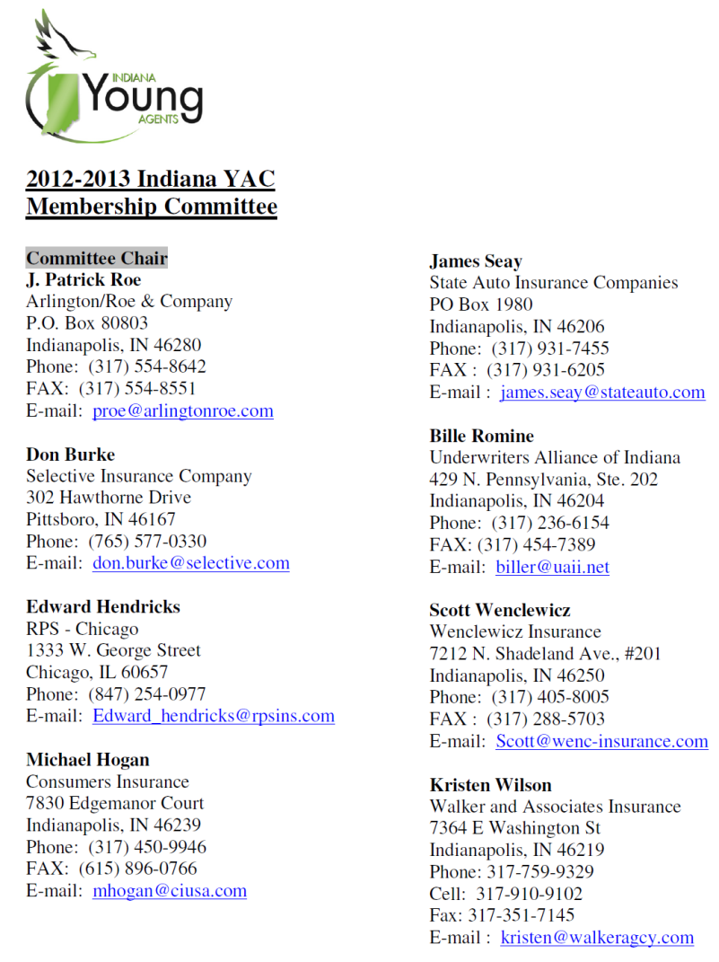
Indiana YAC Membership Committee
Employ this committee to:
Set Goals
Illustrate Importance of Membership
Carry Out Projects, Recruit Members, etc.
Get More Involvement Opportunities
Note: Makeup of Committee is
Majority Company/MGA People

Slide 3
You Charge Dues…Really?
$25 Annual Membership Fee
Charged to Both Voting Members and
Associate Members
Generates Some Revenue
Main Reason: Creates Buy-In
Members Have “Skin in the Game”

Slide 4
Goal Setting is Imperative
Indiana YAC – Currently 262 members
Increased Our Members by 19 in 2011-2012 (from 243 to 262)
Meet at Beginning of Each Year to See Where We are – Number of Members
Set Challenging, Yet Achievable Goals (for 2011-2012, Indiana YAC Set Goal of Maintaining 250 members)
Provides Base Line and Evaluation Point for What We are Doing

Slide 5
Membership/Potential Member Contact Lists
Everything Done Via Email
Indiana YAC Maintains Contact Lists for Both Active, Dues Paying Members and Potential Members
Allows for “Cleaner” Line of Interaction With Current Members
Annually Run Query of IIAI Database for Individuals Under Age of 38 for Potential Members
Provides Targets for Recruitment
Key To Recruitment Activities

Slide 6
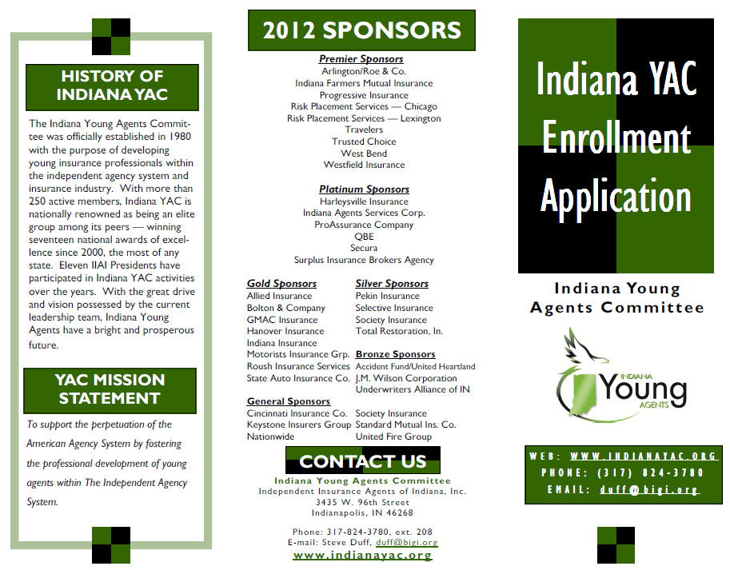
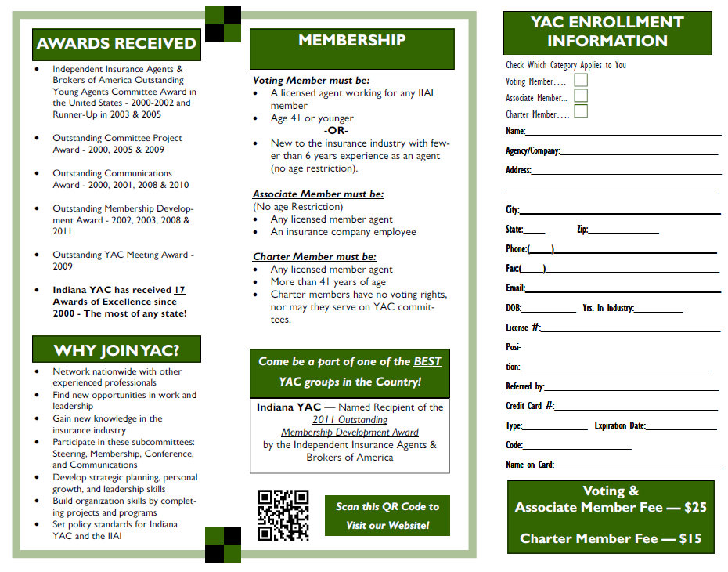
New Member Recruitment Tools
Employ a Multi-Pronged Approach
Centerpiece – Indiana YAC Membership Flyer
Direct Email to Potential Members (under age 38 database)
“Call Center” – Contact Agency Principals
Company & MGA Field People Contacts
Discounts to Events – Get New People in the Door

Slide 7
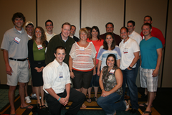
Making New Members Feel Welcome – IMMEDIATELY!
Welcome Packet
Sent Within Three Days of Joining
Welcome Letter from Membership Committee Chair
Lapel Pin
Indiana YAC Membership Certificate
Recognized at All Events
New Member Reception at
2012 Indiana YAC Conference

Slide 8
Member Retention
Association Management 101 Says:
“It is easier and less expensive to retain an existing member than recruit a new one.”
Give as Much Bang for Membership Dollar as Possible
Show Value of Being a Member and INVOLVED!
Networking and Educational Events (price breaks for new people and first time attendees)
Regular Interaction
Newsletters, Blast Emails, Social Networking, Committee Participation, IIAI Feature Stories on YAC, IIAI Leadership Interaction

Slide 9
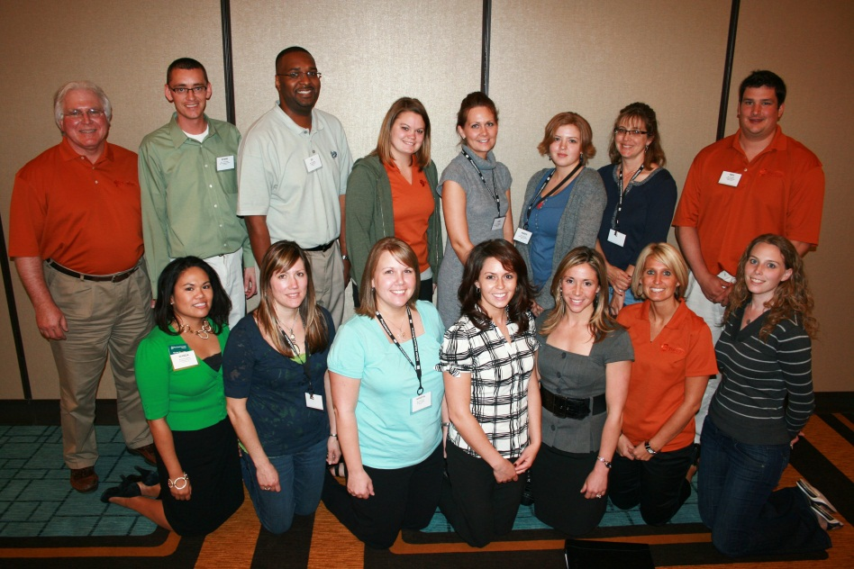
Charter Members
Created New Membership Category
Any Industry Employee – Over Age 41
Pay $15 Annually – Receive Our Materials
Allows “Veteran” Agents to Stay Involved
21 Indiana YAC Charter Members
See the Guy Standing on the Far Left of this Photo?
Former IIABA Chairman Mike Miley – Indiana YAC Charter Member

Slide 10
Contact Us
Feel Free To Contact Us Any Time
Steve Duff, IIAI Indiana YAC Staff Liaison
(317) 824-3780, ext 208, duff@bigi.org
J. Patrick Roe, Arlington/Roe & Company
2012-2013 Indiana YAC Membership Committee Chair (317) 554-8642, proe@arlingtonroe.com
Indiana YAC Website: www.indianayac.org

