Slide 1
2012 OUTSTANDING YOUNG AGENTS COMMITTEE AWARD
The Young Agents Committee of the Independent Insurance Agents of Georgia. Inc.

Slide 2
2012 OUTSTANDING YOUNG AGENTS COMMITTEE AWARD
In recognition of the outstanding efforts of a state Young Agents Committee, to foster association growth and secure the future of the independent agency system.
The Young Agents Committee of the Independent Insurance Agents of Georgia. Inc.

Slide 3
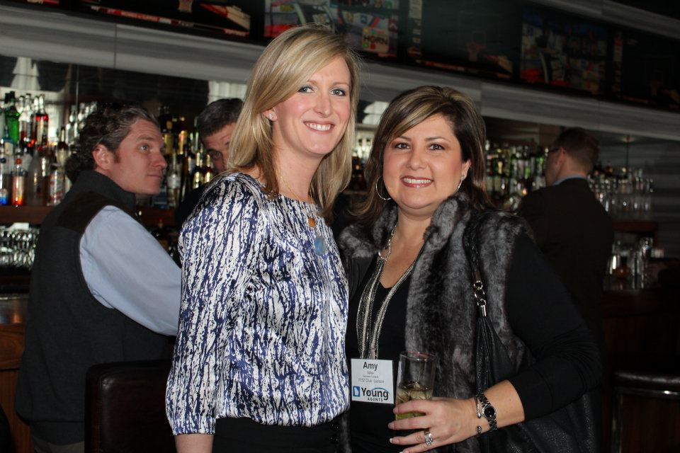
COMMUNICATIONS
5 YAC-specific Communications Channels, 5 Additional Publications & Website Presences
Purchased several domain names to aid in YAC Event Promotions
Over 30% increase in promotional coverage
Focused on streamlining communications and increasing exposure (living flyers on sites)
Heavy emphasis on social media and new text message notification system; over 80 members currently use our text service!
Utilized pictures and video services for delivering YAC promotional messages
Winter 2012 YAC Mixer at Whiskey Blue –
W Hotel Buckhead in Atlanta, GA

Slide 4
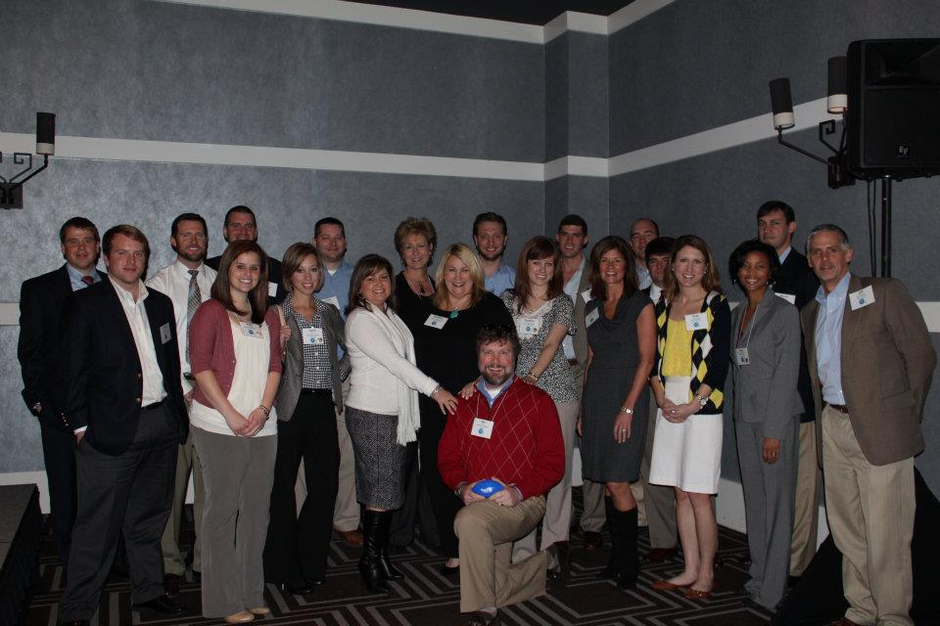
MEMBERSHIP DEVELOPMENT
Utilized online learning opportunities providing CE to Young Agents year-round
Contests on Facebook for conference registrations helps engage members while apart
Holds mixers and networking opportunities between state events to keep everyone plugged in
Most of all, our Young Agents have fun together!
Part of the Group at YAC Sales & Leadership 2012

Slide 5
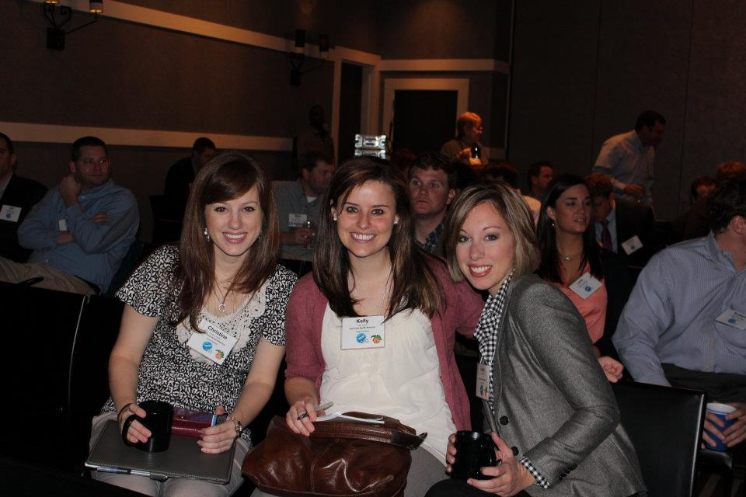
MEMBERSHIP DEVELOPMENT
Grew our membership by over 11%
On-site recruiting at agencies, state events, and joint events with outside organizations
New member welcome events, packages. Also implemented a new membership registration process: www.GeorgiaYAC.com
Offered a mentor program, Young Agent Awards
Used magazines, social media, websites, and created YAC Calling Cards to give to prospective members & partners to get them engaged and plugged in!
66% of Young Agents Attended Legislative Conference, 60% of Young Agents Attended Annual Conference. 20% Attended Big I Legislative Conference & Convention.
Conventions, conferences, and mixers give
members opportunities to catch up!

Slide 6
POLITICAL INVOLVEMENT
Exceeded YAC fundraising goal by 215% - a higher percentage than 44 other states!
Raised over $10,000 from both Veteran and Young Agents.
Encouraged all YAC Board Members to contribute to InsurPAC
50 Young Agents Attended Regional Legislative Meetings, 20% of total attendees at said meetings
Each regional legislative meeting was worth 1 hour of CE
Young and Veteran Agents at Big I Legislative Conference with Georgia Representative Paul Broun, M.D.

Slide 7
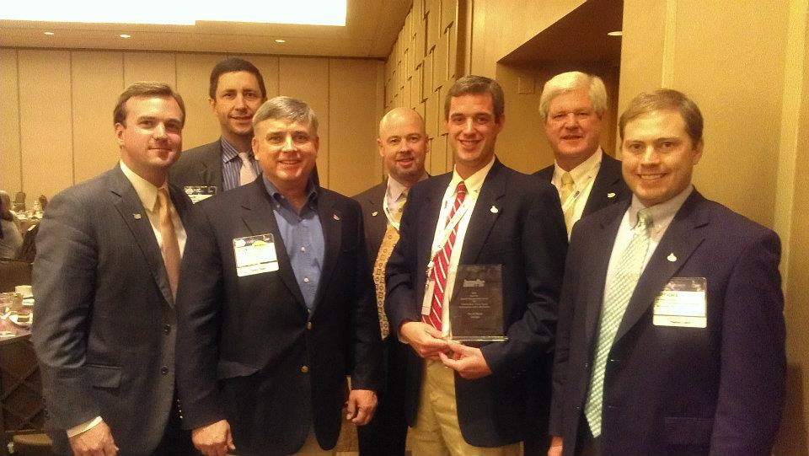
POLITICAL INVOLVEMENT
15 Young Agents attended the 2011 Big I Legislative Conference & Convention
Georgia’s YAC InsurPac Chairman, David Monk, received the National InsurPac Agent of the Year Award for 2011 at the National Legislative Conference in Washington, D.C.
David Monk with Young and Veteran Agents at
the National Legislative Conference

Slide 8
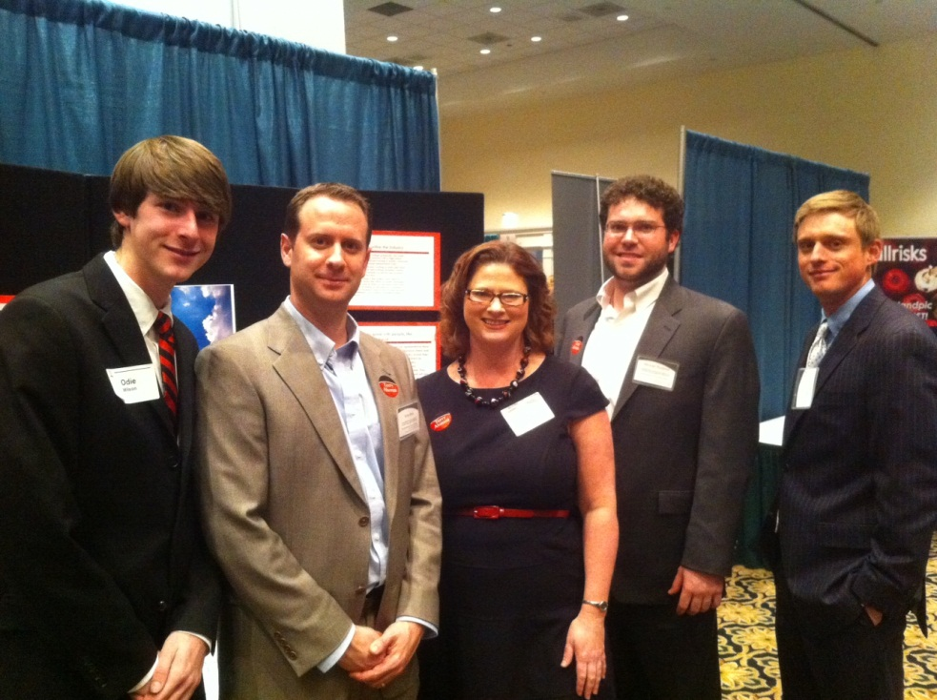
GA InVEST
12 High Schools in Georgia
InVEST had 30% increase in volunteer participation
Participated in career days, classroom visits
Presented on InVEST to company partners
Implemented a silent auction at our Annual Convention for InVEST that raised $3,700
The YAC InVEST Team at UGA’s Career Fair

Slide 9
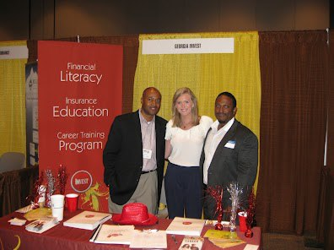
GA InVEST
Hosted a BBQ for the Risk Management Department at UGA
Promoted YAC at College Career Fairs
Invited Students to attend YAC Events free of charge
YAC InVEST Chair and Young Agents
Volunteer at a College Career Fair

Slide 10
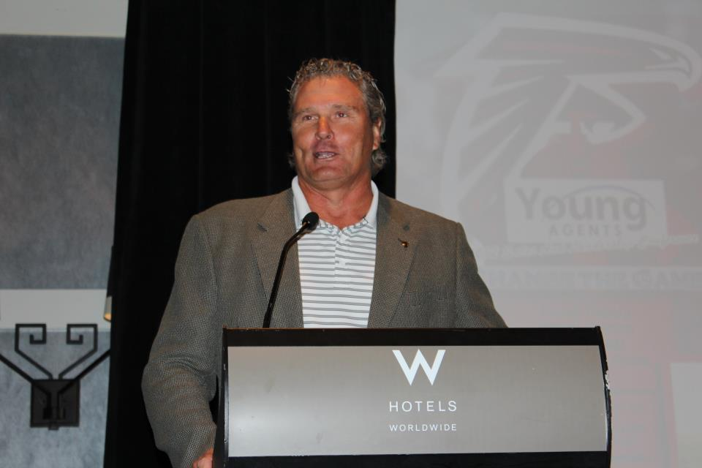
YOUNG AGENT MEETING: Changing the Game, YAC Sales & Leadership
Purpose: to provide education and networking opportunities for IIAG Young Agents
Met at the W Hotel in Atlanta
Institute of WorkComp Professionals presented Thursday, and former All-American NFL Football star Steve Bartkowski concluded the conference
YAC Producers Panel (featuring 4 outstanding YAC members) discussed success methods, daily routines, and work life balance
Steve Bartkowski

Slide 11
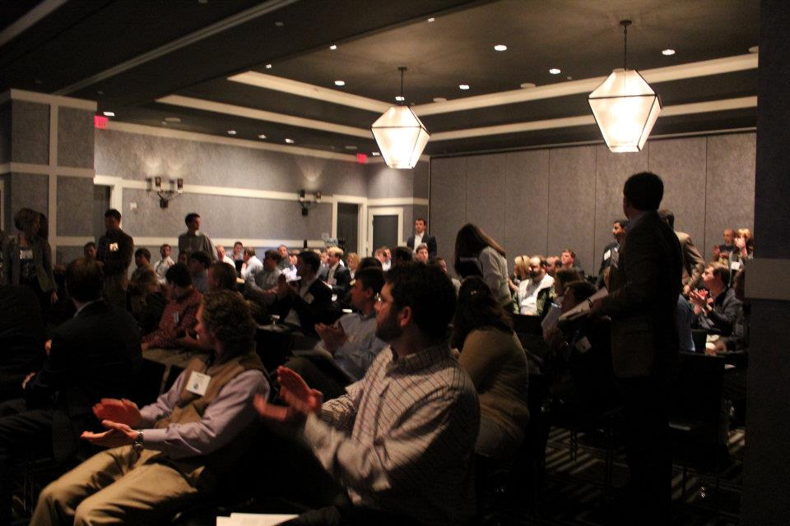
YOUNG AGENT MEETING: Changing the Game, YAC Sales & Leadership
Used text messages, email and phone campaigns, newsletters, and social media to promote conference
Increased Young Agent Attendance by 16%
Welcomed company partners, veteran agents, and IIAG Staff as well
Annual Meeting Budget: $30,000

Slide 12
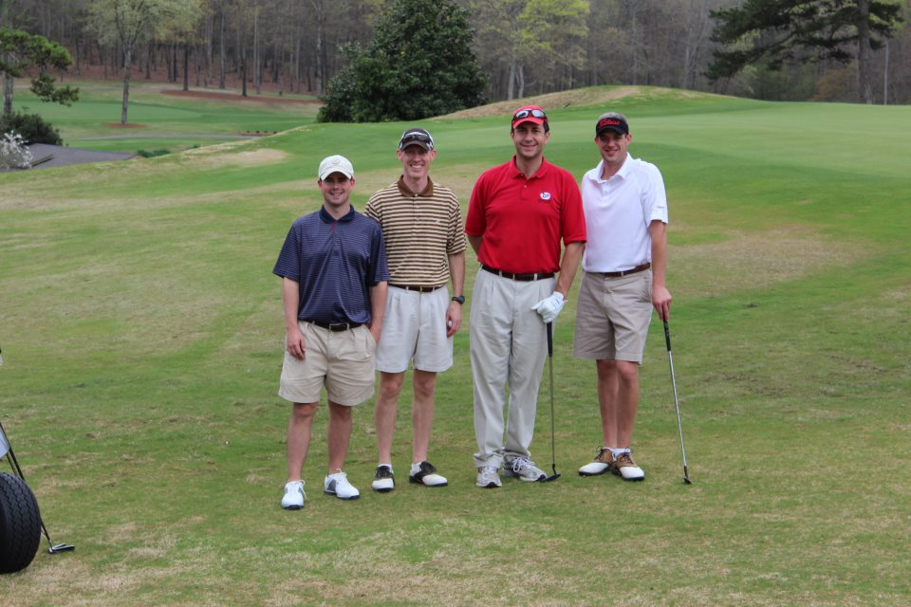
STATE COMMITTEE PROJECT: Georgia Young Agents Charity Golf Tournament
Our goal was $40,000 for charity. Sponsorships and donations grossed $59,000 with $43,094 in net donations!
Supported 12 Bands, an organization dedicated to supporting pediatric cancer patients through the healing power of music
The additional $3094 funds raised benefitted YAC Scholarships
Georgia YAC Members with IIAG CEO Aubie Knight.
The 2012 YAC Charity Golf Tournament was held at
The University of Georgia Golf Course.

Slide 13
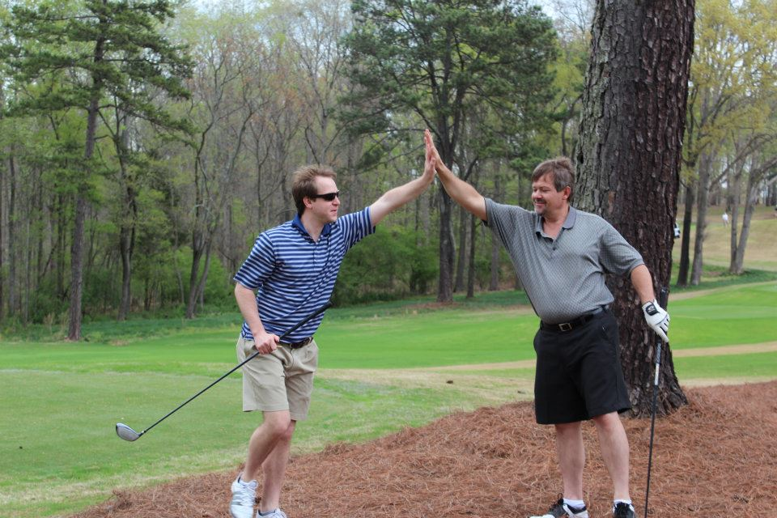
STATE COMMITTEE PROJECT: Georgia Young Agent’s Charity Golf Tournament
Company partners and vendors provided numerous financial sponsorships for the tournament and participated in the play!
Promoted the event through emails, social media, texts, and our “living flyer” website: www.yaccharitygolf.com
Website updated daily to reflect new sponsors & remaining spots available!
Each Board Member was challenged to sell 20 Raffle Tickets in their community. Raffle net just under $3K
Two of our over 120 registrants…
They seem to have done well!

Slide 14
CLOSING
The Georgia Young Agents Committee was able to be tremendously successful in 2011-2012 because of creative, exciting new ways to engage Young Agents. By incorporating students and encouraging potential new members to see what it’s all about, we were able to grow our membership and increase engagement. Using up-to-date, relevant communications and relying on team efforts, we were able to promote our events and fundraisers with unprecedented success.
We’re looking forward to working together towards even more successes in 2013!

