Slide 1
Notes:
Welcome to YAC Chat. Today, we’d like to take a moment to talk to ALL of our states about what’s going on at national YAC. We will be hitting on the Awards, Legislative Conference and the leadership Institute.
But, a few house keeping notes first.
This session will be recorded for future feedback.
We encourage the use of the questions feature in the go to meeting dashboard, we will answer questions throughout the session
We also encourage the use of the chat tool– discussion is welcome.

Slide 2
Company partner slide.
Notes:
A special thank you to our platinum company partners. Without, we would not be where we are today!
Read names

Slide 3
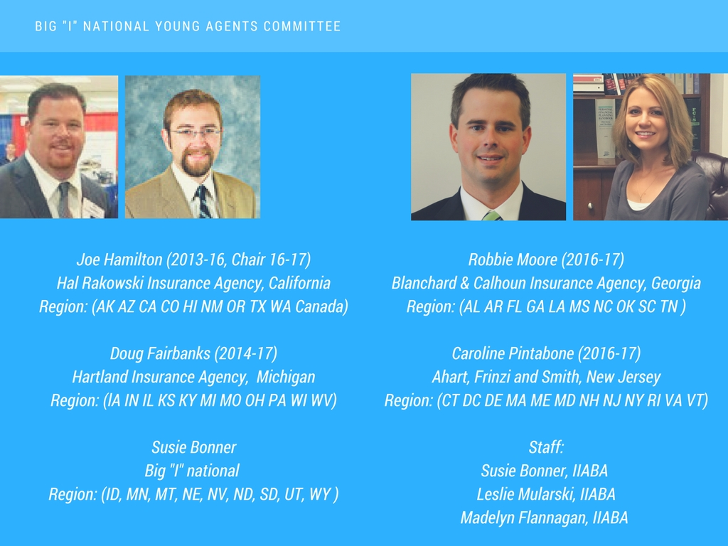

Slide 4
Notes:
This is why we are here. We will be hosting these large group calls quarterly to help us meet our charge.

Slide 5
We’ve Listened.
Easier application process
Earlier application availability
More support from national YAC and staff
Tools to grow your Young Agents program
And we’ve made the following changes:
Changed Committee Project to Community Service
Sunset Communications Awards
Communications is key to the success of ALL YAC activities
Notes:
This is our first step at making the awards a little better for everyone.

Slide 6
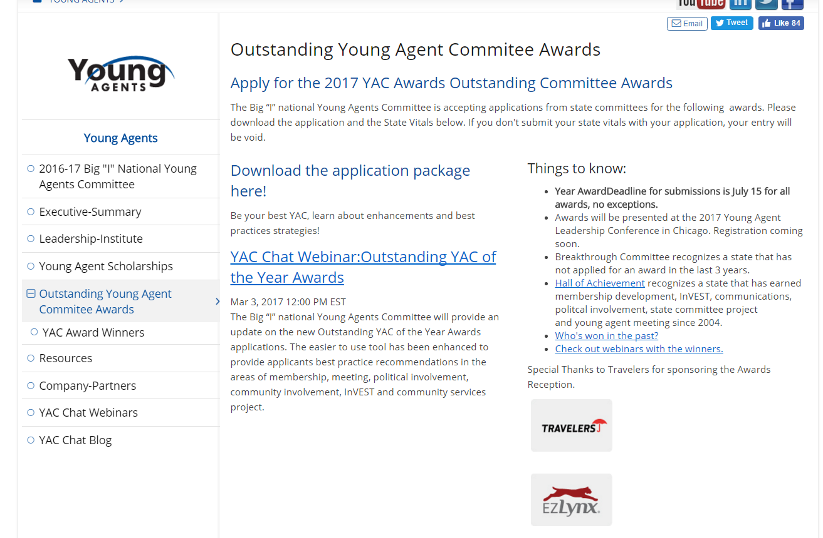
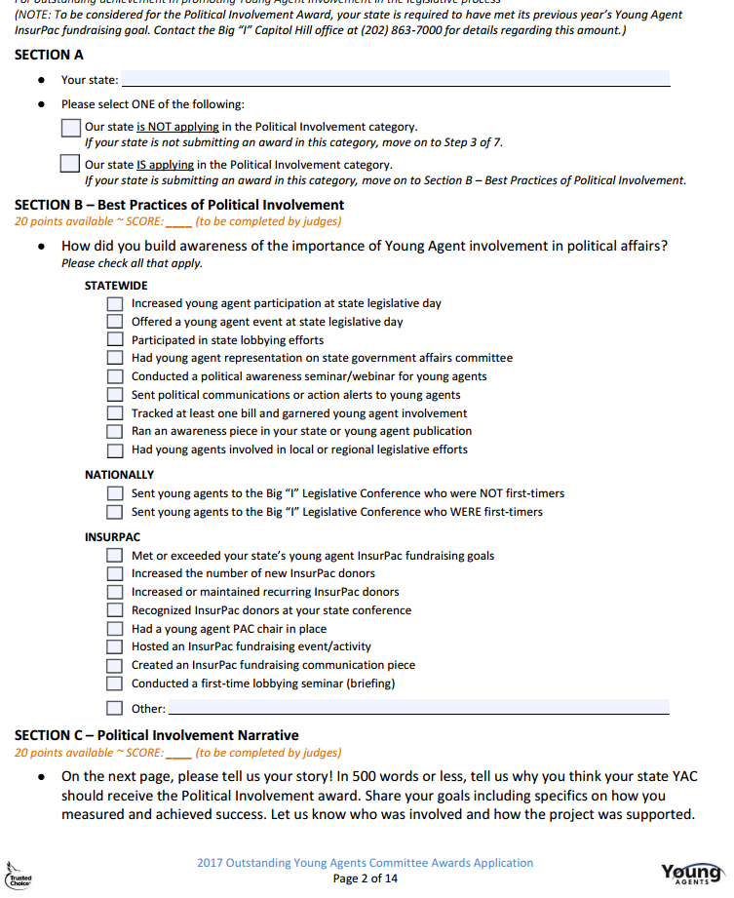
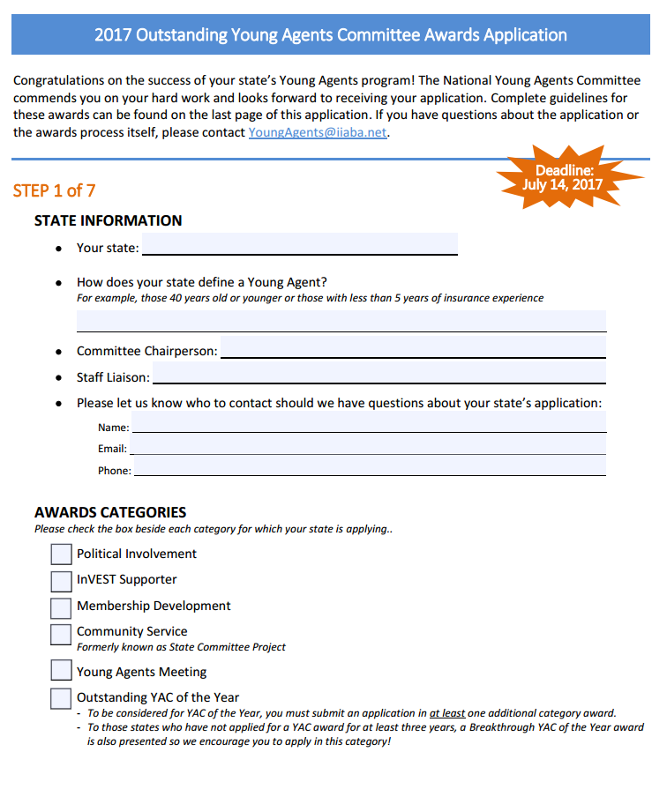
www.independentagent.com/youngagents
Notes:
Go live if I can

Slide 7
Notes:
STATEWIDE
Increased young agent participation at state legislative day
Offered a young agent event at state legislative day
Participated in state lobbying efforts
Had young agent representation on state government affairs committee
Conducted a political awareness seminar/webinar for young agents
Sent political communications or action alerts to young agents
Tracked at least one bill and garnered young agent involvement
Ran an awareness piece in your state or young agent publication
Had young agents involved in local or regional legislative efforts
NATIONALLY
Sent young agents to the Big “I” Legislative Conference who were NOT first-timers
Sent young agents to the Big “I” Legislative Conference who WERE first-timers
INSURPAC
Met or exceeded your state’s young agent InsurPac fundraising goals
Increased the number of new InsurPac donors
Increased or maintained recurring InsurPac donors
Recognized InsurPac donors at your state conference
Had a young agent PAC chair in place
Hosted an InsurPac fundraising event/activity
Created an InsurPac fundraising communication piece
Conducted a first-time lobbying seminar (briefing)

Slide 8
Notes:
CLASSROOM EXPERIENCE
Helped start a new InVEST program at an area school
Worked with InVEST staff liaison to develop or serve on an InVEST committee
Participated in at least one high school or college career day
Had at least five volunteers/guest speakers visit InVEST classrooms
Used an InVEST presentation in the classroom
STUDENT EXPOSURE TO THE INDUSTRY
Hosted one job shadow event or field trip to an independent agency
Hosted one job shadow event or field trip to a carrier’s office
Hosted one job shadow event or field trip to your state association headquarters office
Invited InVEST students to a YAC conference or other educational opportunity/event
Encouraged InVEST students to participate in an industry internship
Encouraged companies and agencies to post internships on the Big “I” Insurance Career Center
FUNDRAISING & SCHOLARSHIP AWARENESS
Educated students about InVEST Scholarship opportunities
Donated an item to the InVEST Silent Auction
Sponsored the national YAC Gives Back: A Benefit for InVEST Scholarships
Promoted InVEST with ads and articles in Young Agent publications
Promoted InVEST by placing ads or articles in state association or other industry publications
Hosted a fundraiser for InVEST

Slide 9
Notes:
RECRUITING
Visited at least one agency to recruit young agents (visits by state staff, volunteers, or company partners)
Used testimonials from current young agents supporting involvement in association activities
Utilized online videos and/or social media to help in the recruitment process
Conducted one joint event with another organization (association, fraternity, college, etc.)
Used the association website for young agent promotion
Promoted association membership/young agent involvement to newly licensed agents
Created targeted messaging for agency principals regarding the value of young agent activities
Worked with carrier reps to promote young agent activities and involvement
ENGAGEMENT
Held a new member welcome or orientation event
Sent a new member welcome email/snail mail packet
Had committee members/state YAC liaisons make phone calls welcoming young agents
Had committee members/state YAC liaisons make phone calls inviting new young agents to events
Hosted recurring calls/webinars/virtual education
Recognized new young agents via a listing on your state website, in an article, at an event, etc.
RETENTION
Featured young agent profiles in a state or industry magazine
Presented a Young Agent of the Year award
Had a young agent booth or hosted an event in conjunction with a state association event
Offered a mentorship program to new young agents
Asked new young agents to volunteer in committee and/or association activities

Slide 12
Notes:
To apply for YAC of the year, you need to apply for more than one award, and write an additianll essay

Slide 13
Notes:
I’ve heard people say they are afraid of the essay, maybe you don’t write every day, but there is nothing be afraid of, we just want a good story.
To make it esasier, create a writing process.
Start with an outline of achivements, or bullets you don’t want to miss,
Move into qualifying that information via testimonials, stories and numbers– what makes you proud, why do you think you should win.
TAKE YOUR TIME.
You’ll get what you give.

Slide 14
Deadline July 14

Slide 15
Open Forum: What we can do for you?
Notes:
Any questions or comments?

Slide 16
Notes:
Each year we attract the best of the best to the Big “I” Young Agents Leadership Institute national conference held in conjunction with the Big “I” Fall Leadership Conference. The annual event is designed for agents, those in volunteer leadership position and state association staff. We provide take a ways to help you in your agency, association and leadership ranks.

Slide 17
Notes:
We want to get to know you– be sure to follow-us on social for news for agents. And, make sure to check out our area of the national website for blog posts, web chats and other resources you can share. Finally, keep in touch with your committee. When susie sends out the follow-up recording, she’ll include the names and emails of your national YAC contacts and of course, you can always reach out to her.

