Slide 1
2014 OUTSTANDING COMMUNICATIONS
The Young Agents Committee of the Massachusetts
Association of Insurance Agents

Slide 2
2014 OUTSTANDING COMMUNICATIONS
For outstanding achievement in maintaining a communications campaign dedicated to young agents

Slide 3
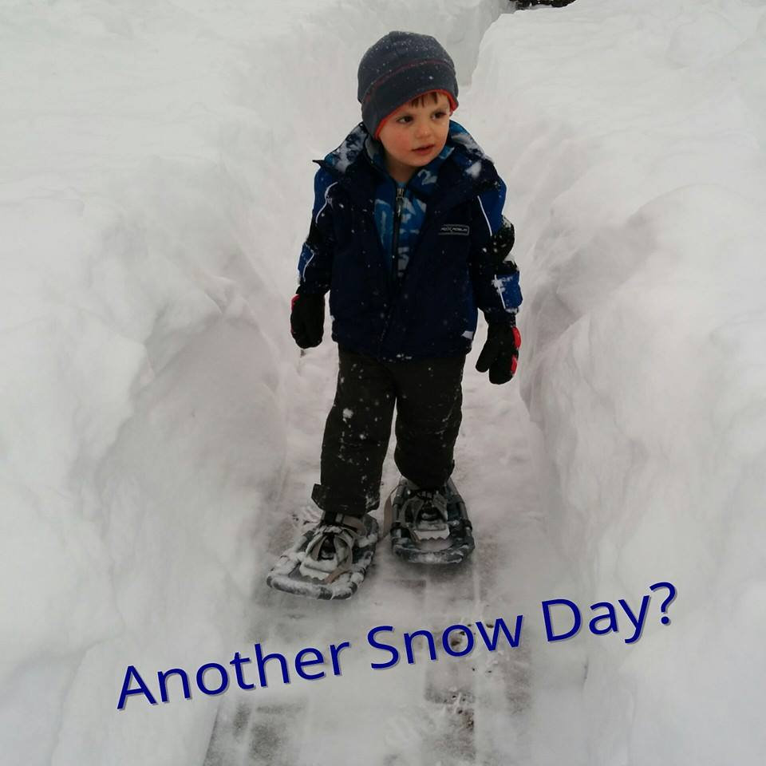
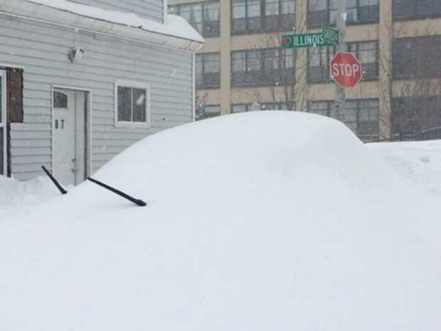
Massachusetts right now…
90+ inches of snow

Slide 4
Communications Paradox: Communicate only by email / Don’t send too many emails
We asked
Communications survey (Survey Monkey). Most were satisfied with the frequency, length & sources our communication.
Complement the already robust communications schedule coming from the association.

Slide 5
Focused on:
A Better Website
Increasing Social Reach
Email Strategy

Slide 6
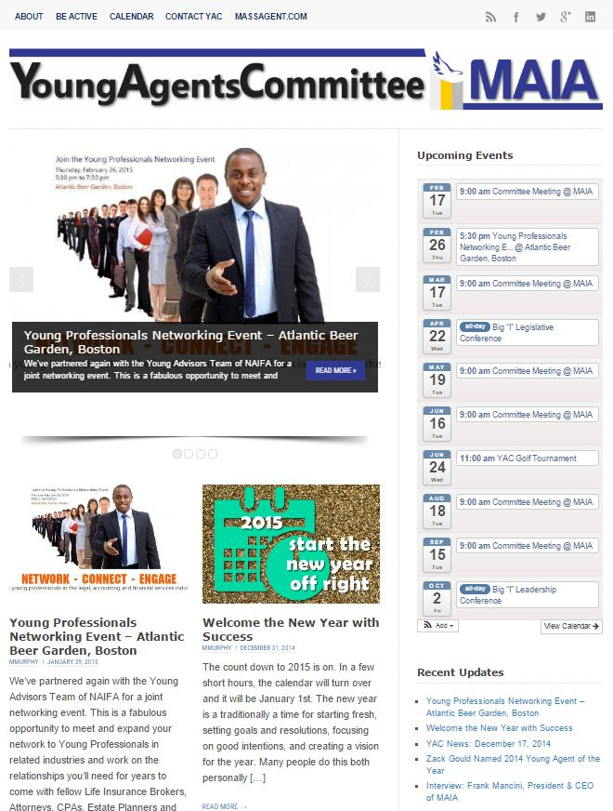
A Better Website
Moved off the association page
massyac.com

Slide 7
A Better Website – What Worked
Wordpress – low cost solution ($100 and 10 hours of time to start).
Content can be updated as it happens and then aggregated for a newsletter.
Start small and build functionality needed with plugins.
Favorite Plugin: “All in One Event Calendar”

Slide 8
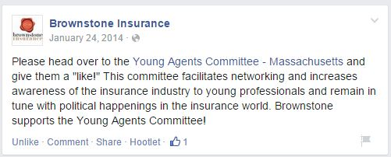
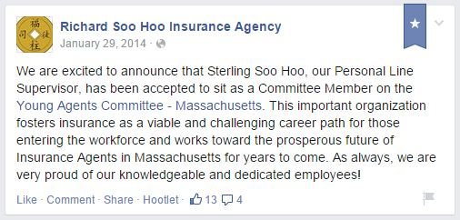
Increasing Social Reach – What Worked
Asked committee members promote the YAC FB page on their agency pages.
Increased by 100+ followers in 2 days time.
Notes:
up to 296 vs. 161 a year ago
The use of targeted Facebook ads have also been useful in promoting events in geographic regions outside the Boston area.
Focus on sharing things central to the mission of YAC – so leadership, networking, generational advice Technology. Weird things from Mashable or the HuffPo.
Look at the stats – when are people looking or clicking on you?

Slide 9
Increasing Social Reach – What Worked
up to 296 vs. 161 a year ago
Share items central to the mission of YAC – leadership, networking, generational, technology. Not just industry stuff.
Look at the stats – post when people are looking/clicking
Notes:
up to 296 vs. 161 a year ago
The use of targeted Facebook ads have also been useful in promoting events in geographic regions outside the Boston area.
Focus on sharing things central to the mission of YAC – so leadership, networking, generational advice Technology. Weird things from Mashable or the HuffPo.
Look at the stats – when are people looking or clicking on you?

Slide 10
Increasing Social Reach Challenges:
LinkedIn (is a mystery)
Group has 263 members but is not very active.
Twitter Best for listening & finding great articles.
Using Hootsuite’s “Suggested” feature to create content.

Slide 11
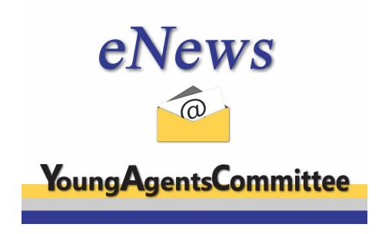
Email Strategy:
Quarterly Newsletter
Allows us to discuss key events during the year...
Big “I” Legislative Conference
YAC Golf Tournament
The Big Event (MAIA's Conference & Trade Show)
End of Year Wrap Up
Include an interview feature with a young agent or notable industry person

Slide 12
List Segmenting:
Send to approximately 600
Previously sent to 12,000. This did not affect event attendance. 50%-60% open rates.
We can include owners and principles when warranted (1180).
Further target based on whether or not they are listed as a young agent, position, geographic region & what they have previously attended.

Slide 13
Email Strategy - What Else Worked:
Welcome Email for all new Young Agent subscribers.
Event promotion – start min 4-6 weeks out.
Email once targeted to YACs only, one reminder, then to principals.
Always include “Forward this to other young agents in your office”.
Event Info on the website, cross post on all social and create a Facebook Event.
Create banner ad and/or content for other association newsletters.
Send a Wrap Up with thoughts and notes for speaker-focused events.

