Slide 2
Notes:
First of all, thank you to National for the recognition of our outstanding meeting. We were extremely pleased with the turnout, but to be able to brag that it was the best in the nation goes a long way towards our future marketing. Thank you also for joining us today. We are Patrick Roe and Rhiannon Fox, Committee Chairs for our Indiana Young Agents Committee. We hope to keep this engaging and give you a worthwhile look at our conference and the reasons it was successful.

Slide 3
Notes:
To give you a little background on what the Indiana association looks like, we are NOT a merged state, meaning that we compete with PIA to attract members - and for attendance at events. The Indiana PIA recently formed their own Young Professionals group also, but mainly functions as a year-long training course for a small number of agents.
We have around 650 member agencies throughout the state, representing 4,269 agents. Of these, we only have the birthdates of 656 under the age of 41 in our database. Though we target that audience, we always make sure to include everyone in the promotion of our activities and events and continue to gather those birthdates to keep our data relevant. We have 133 associate members, made up of companies, wholesalers and vendors. Included in that number are 60 Partners, who receive at least one complimentary registration to the Young Agents Conference.

Slide 4
Notes:
In regards to our marketing, we did the typical email blasts, but also had a printed pamphlet addressed to the agency principals. We distributed these to our company partners and asked them to take them on their agency visits. The paragraph listed here says “Over the next 10 years, 50% of current agency works will have retired. The next generation of leaders are ready to get involved now.”

Slide 5
Notes:
One week prior to the event, we sent a message to the attendees to let them know what to expect at the conference. This included information about dress code, how to find a staff or committee member, and helpful notes about each session – and included the full menu that would be offered for each meal.

Slide 6
Notes:
The conference welcomed a record number of attendees (111), including 37 new agents who were attending a Big “I” event for the first time. We may have had a huge benefit with so many new faces attending their first event, as they were very receptive to instructions. As you know, some longtime attendees who know the drill don’t always follow along as we’d like them to. This group was incredibly respectful and cooperative, so it allowed for everything to flow very smoothly.
We offered 10 hours of CE credit, including a risk management walking tour around the Indiana University campus, a clear favorite with attendees. There were also classes on managing your E&O exposures, employment practices liability, and protecting your clients’ information. The variety of subject matter and quality speakers kept attendees engaged.

Slide 7
Notes:
One major change to the conference was the decision to drastically drop the cost to attend for agents. The entire conference, including CE, all meals and events, was only $79 for three days. We wanted to make sure that cost was not a deterrent for agents to attend the event. We charged our non-agent friends $199 and there was absolutely zero kickback in that pricing structure, though as mentioned earlier, our Partners do receive at least one free registration, even at the General level. In the post survey results we learned that 100% of attendees said they hoped to attend again the following year.

Slide 8
Notes:
We decided to keep the conference somewhat central to the state, and Bloomington is a great college town with a progressive feel. We went to Indiana University and held our meeting at their Memorial Union, which has an attached hotel. The meeting room we choose had space in the back so that we could also keep the breakfast and lunches in the same room as the CE. We often announced our intention to keep the food lines open and for people to get what they needed to enjoy their meal without rushing. Attendees who attended IU were particularly at home, but even those from other colleges loved the youthful feel and energy that the campus had, along with the convenience that this location afforded.

Slide 9
Notes:
The Amazing Race event was the perfect way to jump start the conference. We assigned everyone to a team so that they had a chance to meet new agents and company people. Then we sent them on a scavenger hunt around the entire Indiana University campus. It was a great way to get people moving and interacting.

Slide 10
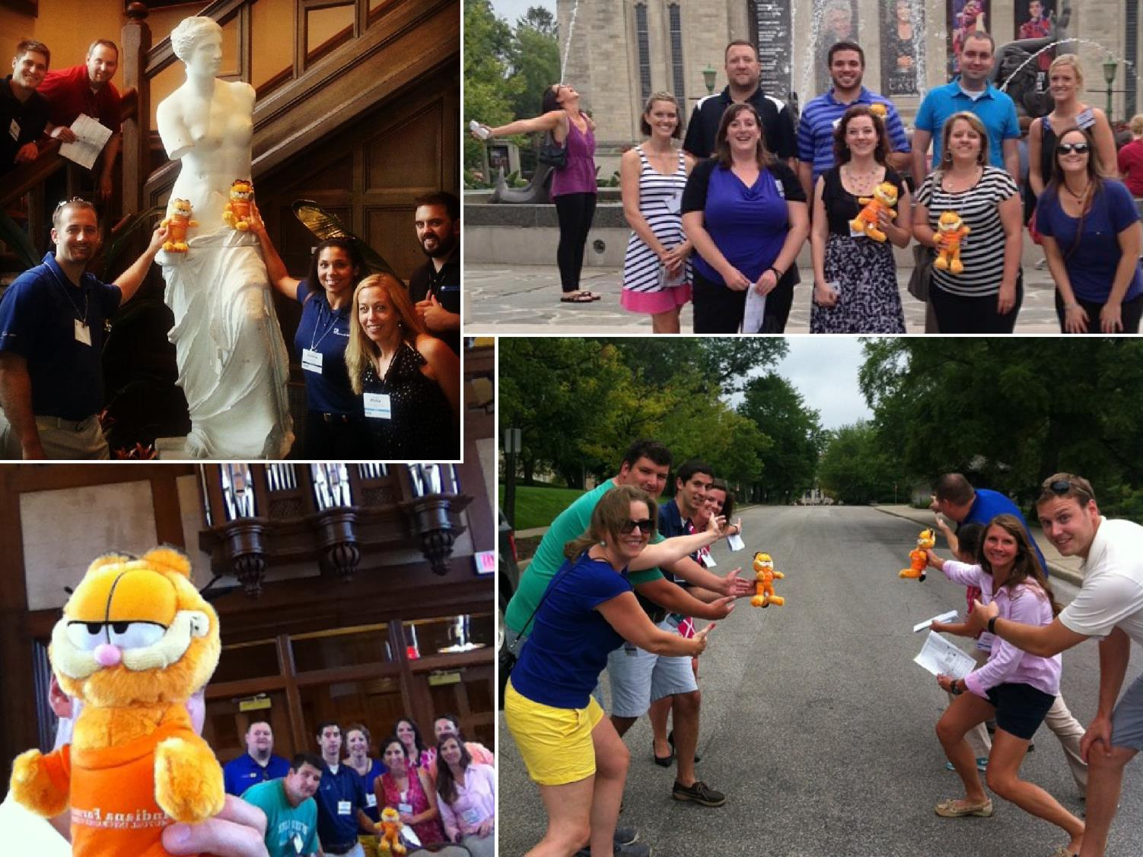
Notes:
When they found their intended spot, they had to Instagram a photo of their team there, including the sponsoring company’s mascot, Garfield, who appears in their logo. We awarded prizes for all members of the winning team, and also awarded very small silly prizes for the most creative Instagram photo, so their photos were always unique and fun at each stop. This offered awesome publicity on social media also, as they had to use a specific hashtag to log the photo.

Slide 11
Notes:
That evening, our attendees returned very warm from running all over the campus in the hot July weather, so we gave them time to shower and change before we invited them to a local pizza pub, which was walking distance from our conference location.
As they entered the pub, each attendee was given a name tag with a unique TV characters name. Under that character name listed the number of other characters from the same program that they needed to find in the crowd. The first team to find all of their characters and get their photo taken by us won more silly prizes. In this case, it was candy and superhero masks.

Slide 12
Notes:
In the morning, we offered a hearty breakfast beginning at 8:15 am, with our CE beginning at 9 am. Our attendees were able to either sleep in or get some work done in their hotel rooms before coming down for the conference. Since the food was at the back of the room, even those who walked into the room at 8:59 am were encouraged to grab a plate and eat leisurely, and the food remained set until around 10 am for attendees to return for more if they’d like. This seems to be a huge win for our attendance and participation in the morning CE classes, not to mention attendee satisfaction levels.
Since we’re talking about food, we’ll tell you that the food was a huge hit on our survey results. We believe that the food was good, but they really enjoyed it because they knew what was coming and at what time. As we mentioned earlier, we did this by including the full menu in the pre-communication and onsite agenda. Somehow, by knowing that we were going to have a taco bar for lunch made our attendees love tacos about 100 times more than they might have otherwise.

Slide 13
Notes:
Continuing our 2nd day of the conference, we started at 9 am with a CE session called “Managing E&O Exposures in a 24/7 World”. This session took us right up to noon, where we broke for the lunch hour, and at 1 pm we resumed with a 3 hour Risk Management Walking Tour around the Indiana University campus. This was the highlight of all of the CE, as attendees were able to get up and moving. The session was led by Angie Heavener, and the university’s Loss Control manager’s team of 5 people. The instructor was incredibly prepared and she and the university team coordinated before the conference to develop a really tremendous program.

Slide 14
Notes:
That evening, starting at 6 pm, we shuttled everyone to a local winery about 7 miles away for dinner and live music. This was the perfect complement to the simple dinner the previous night where we offered beer and pizza, this was a nice full dinner and wine. The winery offers a beautiful outdoor terrace and our catered meal was delicious. Our live entertainment was a two-piece band that played great acoustic covers.
Our Friday morning CE session wrapped up our conference. It was held from 9 – 11 am and we again did a full breakfast. Friday morning is always our struggle for attendance, but breakfast was the hook and many stayed for the class.

Slide 15
Notes:
In a post-event survey, we asked attendees what their top reason was in attending. 75% said networking was the most important reason they decided to attend. Events came in at a strong 2nd for most important reason in attending. CE didn’t register well on our survey, though we still feel that the continuing education hours are the glue that holds the event together, especially in the eyes of an agency principal.

Slide 16
Notes:
The free-form survey comments were the true vindication of our hard work, including some of these, when asked “What did you like about this conference?”
“I liked that we had plenty of time to get in CE hours, but also plenty of time to meet new people and network ourselves and have some fun.”
“The ice breakers were great ideas to get folks engaged.”
“I really liked how the scheduled events required interactions with others. Nicely done.”
“The walking tour of the campus was fantastic. The activities we participated in to get to know other attendees was great as well!”
“I thought this was one of the best run conventions ever.”
“I really enjoyed the social aspects of the conference. The ability to talk with other professionals in the industry is very important to me.”
“The events were great. I particularly loved The Amazing Race as it gave me a chance to get to know people I might not have otherwise.”
“I also liked how the meals were integrated in the same room as the classes. This took the pressure off to eat fast.”
“I thought most of the sessions were interesting. I liked that the dress code was relaxed to accommodate for the heat when walking outside for sessions/activities. The networking opportunities were great. I thought the "after-work" activities were fun and relaxing. Even the small details, like having a list of all the attendees as well as the food at the conference was well planned.”
“CE classes were informative and interesting; the walking tour was a great way to get out of the classroom and learn in the field.”
“Ran smoothly and everyone was very friendly. Activities were fun and interactive along with the food being awesome.”
“I like the opportunities for networking. The beer/pizza and winery gave me a chance to do just that. It also wasn't too busy where I didn't have any downtime for myself.”

